Slide 1
Chapter 4 Thread & Concurrency

Slide 2
Outline
Overview
Multicore Programming
Multithreading Models
Thread Library
Implicit Threading
Threading Issues
Operating-System Examples

Slide 3
請寫一個計算矩陣相乘的程式
你要怎麼寫呢?

Slide 4
Solution 1: Single Process Solution
memory
Assume four CPU cores are available
Core 1
code
data
Core 2
stack
…..
Core 3
1. Three CPU cores are idle
2. This process has long execution time
Core 4

Slide 5
Q: Your Solutions?

Slide 6
Solution 2: Multiple Processes Solution
code
Assume four CPU cores are available
Core 1
data
fork()
stack
fork()
fork()
Core 2
…
code
Core 3
data
All of the four CPUs are used.
Execution time is reduced.
3. But, the code and data sections of these four processes are all the same (memory wastage)
stack
Core 4
…
…
…

Slide 7
Q: Your Solutions?

Slide 8
Solution 3: Multiple Threads Solution
one process
memory
Assume four CPU cores are available
code
Core 1
create_thread()
data
create_thread()
stack
create_thread()
Core 2
stack
stack
All CPU Cores are busy
Memory usage is economic
The execution time is minimizing
Core 3
stack
Core 4

Slide 9
Motivations
Problem: global warming (全球暖化)
Solutions
1. Reduces personal desires
2. Resource sharing
Problem: process is high overhead. Why?
Solutions
1. Reduces personal desires: minimize code size or shorten execution time
2. Resource sharing: threads

Slide 10
問題:什麼是Threads?

Slide 11
Thread Overview
Problem: Process is an high overhead abstraction
E.g., creating process is as an expensive operation.
Each process have its own code, data, heap, and stack segments
Solutions: thread
A basic unit of CPU utilization
Thread可視為一種特殊的process (藉由共享的輕量化process)
執行process內部的一段程式碼

Slide 12
OS會分配CPU執行thread
See the following slide
(以下討論我們都假設是one-to-one model)(shown later)

Slide 13
If Three CPU Cores are Available
main() {
pthread_create(runner());
x = x +1;
y = y + 1;
}
runner() {
pthread_create(readrun());
i = i + 6;
j = j * 8;
}
readrun()
{
c = c + 2;
d = 10 ;
}
a process
Thread 1
Thread 1
If three CPU cores are available, these three threads can run in parallel
Thread 2
Thread 2
Thread 3
Thread 3
Multithreaded Process: an application can have
several different threads of activity within the same address space

Slide 14
我們比較一下processes
See the next slide
(假設有兩個CPU cores;兩個processes同時執行不同的code sections, 但是兩個code sections的內容都相同)

Slide 15
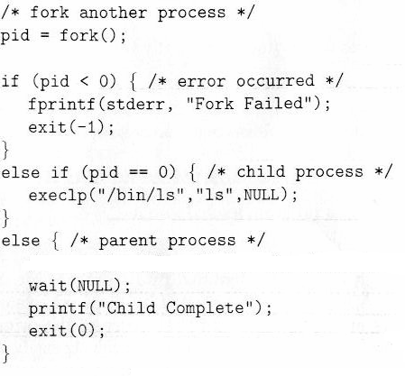
memory
printf(“hello\n”);
假設子承父業, child沒有呼叫exec() system calls

Slide 16
複習: 在第三章提到如何讓Process順利執行呢?
給它需要的資源
例如: CPU, 記憶體(code section, data section, heap section and stack section)…

Slide 17
同理, thread也需要資源, 例如: CPU和記憶體
只是threads彼此之間會共享資源

Slide 18
同樣的, 在thread執行的過程中, 也會有狀態的變化

Slide 19

複習: Diagram of Process State

Slide 20
同理, 我們也必須記錄thread執行時的相關資訊!

Slide 21
複習: Process Control Block (PCB)
Keep information associated with each process
Process state
Program counter: address of the next instruction
Saved when an interrupt occurs or context switches occurs
CPU registers
Saved when an interrupt or context switches occurs (introduce later)
CPU scheduling information: process priority……
Memory-management information: will be introduced later
Accounting information: CPU time and real time used…..(see following slide)
I/O status information: Open files and devices…

Slide 22
Thread Control Block (or Thread Descriptor)
Each thread has its own TCB, like each process has its PCB
Thread ID
Thread State (Run, Waiting…)
Program Counter
Registers
……

Slide 23
Thread Control Block (TCB)
Thread 1
…
out eax, 0x60;
add eax, ebx;
…
add eax, 0x30;
add ebx, eax;
……
CPU
Thread 2
…..
T1 TCB
pc = x, eax=y, …..,
OS
T2 TCB
pc = i, eax=j, …..,
OS
OS

Slide 24
Question: 如前述, threads之間會共享資源, thread和誰共享資源?
Ans: 同一個process下的其他threads.
例如前面投影片的三個threads彼此共享資源(如: code section)

Slide 25
Question: 那些資源可以共享?那些不行?
CPU? Code Section? Data Section? Heap Section? Stack Section?......

Slide 26
Thread Overview
不可共享
Thread need resources like thread ID, program counter, register set, and stack section
為什麼這些資源不可共享?
可共享
Other resources are shared with other threads belonging to the same process
Code section, data section, heap section, and other resources, such as open files and signals

Slide 27
複習: Thread Overview
不可共享
Thread need resources like thread ID, program counter, register set, and stack section
為什麼這些資源不可共享?

Slide 28
Question: 為甚麼thread ID不能共享?
Hint: 舉個例子說明thread ID相同會有什麼問題?
Ans: setpriority(PRIO_PROCESS, tid, prio)

Slide 29
複習: Thread Overview
不可共享
Thread need resources like thread ID, program counter, register set, and stack section
為什麼這些資源不可共享?

Slide 30
問題：為什麼同一個Process下的Threads不共享Program Counters和Register Set?
Hint: program counter也是register. 所以上述問題就是為什麼同一個process內部的threads不能共享暫存器

Slide 31
Q: 我們先問一個問題, 何謂共享暫存器?
Hint: 事實上,暫存器的本質就是共享的
Thread A執行時使用暫存器, context switch, 然後thread B執行也使用同樣的暫存器

Slide 32
可是直接共享會有什麼問題呢?
Hint: 第三章我們看過

Slide 33
如果直接共享暫存器
Thread 1
…
out eax, 0x60;
add eax, ebx;
…
add eax, 0x30;
add ebx, eax;
……
CPU
eax | 59
ebx | 25
eax | 10
ebx | 5
Thread 2
…..
OS

Slide 34
問題：怎麼辦呢?

Slide 35
Answer: 目標，我們必須讓threads(邏輯上)不共享暫存器, 因此, context Switch時必須 (1)將目前正在執行Thread的CPU暫存器的值儲存到TCB (2)復原接下來要執行Thread的CPU暫存器的值

Slide 36
Context Switches between Threads - Similar to Context Switch between Processes
CPU
eax = 8 ;
ebx = 11;
Thread 1
main()
{
.
a = a +1;
pthread_create(..runner());
}
runner()
{
.
.
b = b + 5;
c = b * 10;
}
eax = 3;
ebx = 19;
eax = 8;
ebx = 11;
Thread 1
Thread 1
Context switch
Thread 2
eax = 8 ; ebx = 11;
TCB₁
Thread 2
TCB
(in memory)
Thread 2
TCB₂
Context switch
Change to Thread 1
eax = 3 ; ebx = 19;

Slide 37
所以, thread就好像有自己專屬的暫存器
eax = 8
ebx = 11,…
eax = 8
ebx = 11,…
thread 1
thread 1
thread 2
eax = 3
ebx = 19,…

Slide 38
複習: Thread Overview
不可共享
Thread need resources like thread ID, program counter, register set, and stack section
為什麼這些資源不可共享?

Slide 39
問題：為什麼同一個Process下的Threads不共享stack Section ?(see the following slide)

Slide 40
Why Can’t Share the Same Stack?
main()
{
.
.
a = a + 1;
function_1(…);
exit(1);
}
function_1()
{
b = b - 1;
function_2(…);
return;
}
function_2()
{
…
return;
}
stack
ESP
arugment
return address
local variables
ESP
argument
return address
local variables
ESP
argument
return address
local variables

Slide 41
從上圖, 你知道為何同一個process內的threads不共享stack嗎?

Slide 42
所以, 以下兩張圖顯示process和thread的差異

Slide 43
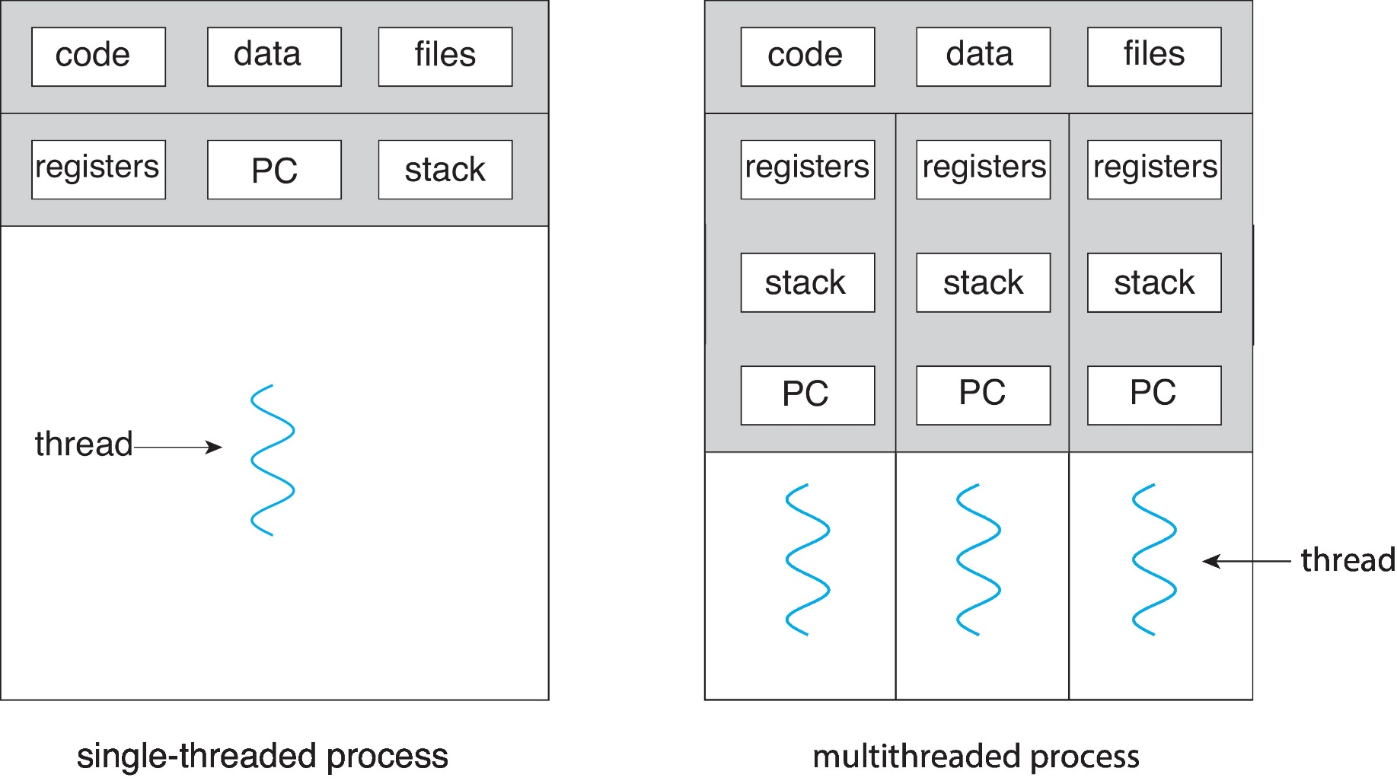
Single and Multithreaded Processes

Slide 44
Create a Process v.s Create a Thread
memory
memory
one process
code
code
data
fork()
data
thread_create()
stack
stack
…
…
stack
New thread
code
…
New process
data
stack
…

Slide 45
但是, 共享data section有時候會出問題
第六章會介紹

Slide 46
結論, thread有那些優點呢?

Slide 47
Benefits
Responsiveness
If one thread is blocked, other threads can continue running
Resource Sharing
Threads share the memory (code and data) and resources of the process to which they belong
Economy
Create and context-switch thread is much quickly than processes
Scalability
Multithreading on a multi-CPU machine increases concurrency
Each thread may be running in parallel

Slide 48
所以, 現在許多應用程式都是multi-threading~

Slide 49
Examples
Example 1: File servers or web servers: needs to handle several requests over a short period. 怎麼辦呢?
1. Process sequentially: bad
2. Create a single process for each request
Process creation is time consuming and resource intensive
3. Create a single thread for each request: more efficient
Example 2: Matrix multiplication
Example 3: Web browser:
One thread: display images or text, one thread: retrieve data
……

Slide 50
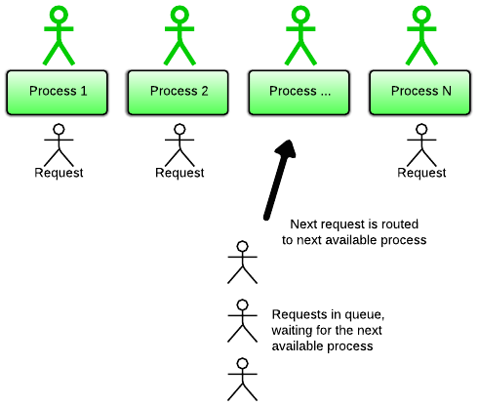
Example 1: File Server: Multi-Process I/O Model
1. Receive requests
2. create a process to service the request
Dispatcher process
Multi-process I/O model. Each process handles 1 client at a time.
https://www.rubyraptor.org/how-we-made-raptor-up-to-4x-faster-than-unicorn-and-up-to-2x-faster-than-puma-torquebox/

Slide 51
Example 1: File Server: Multi-Thread I/O Model
thread
thread
thread
thread
1. Receive requests
2. create a thread to service the request
Dispatcher thread
Multi-thread I/O model. Each thread handles 1 client at a time.
https://www.rubyraptor.org/how-we-made-raptor-up-to-4x-faster-than-unicorn-and-up-to-2x-faster-than-puma-torquebox/

Slide 52
Solution 2: Multiple Threads Solution
one process
memory
Assume four CPU cores are available
code
Core 1
create_thread()
data
create_thread()
stack
create_thread()
Core 2
stack
stack
All CPU Cores are busy
Memory usage is economic
The execution time is minimizing
Core 3
stack
Core 4

Slide 53
Outline
Overview
Multicore Programming
Multithreading Models
Thread Library
Implicit Threading
Threading Issues
Operating-System Examples

Slide 54
今日的電腦都是多核心, 所以寫程式時如何充分利用所有的核心呢?

Slide 55
Outline
Overview
Multicore Programming
Concurrency v.s. Parallelism
Types of Parallelism
Multi-Core Programming Challenges
Multithreading Models
Thread Library
Implicit Threading
Threading Issues
Operating-System Examples

Slide 56
Concurrency v.s. Parallelism
On a single-processor system, processes were running concurrently, but not in parallel
Concurrency supports more than one task making progress
However, with multicore systems, processes can run in parallel
Parallelism implies a system can perform more than one task simultaneously

Slide 57
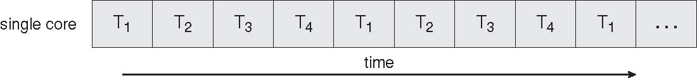
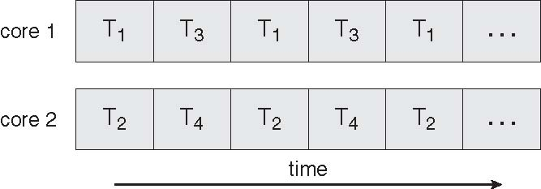
Concurrency vs. Parallelism Four Threads: T1, T2, T3, T4
Concurrent Execution on a Single-core System
Parallel Execution on a Multi-core System

Slide 58
Outline
Overview
Multicore Programming
Concurrency v.s. Parallelism
Types of Parallelism
Multi-Core Programming Challenges
Multithreading Models
Thread Library
Implicit Threading
Threading Issues
Operating-System Examples

Slide 59
今日的電腦都是多核心，所以我們寫程式可以使用multi-threading來實現Parallel Execution，以充分利用每一個Core！
Q: How to make your program multi-threading (i.e., parallel execution)?

Slide 60
Types of Parallelism
Two types of parallelism: data parallelism v.s. task parallelism
Data parallelism
Running the same task on different components of data
Ex: summing an array of size 1000 (if two cores)
Thread A on one core sums the element [0]…[499]
Thread B on another core sum the element [500]…..[999]
Task parallelism
Running many tasks on the same data
Ex: summing and multiplying an array of size 1000 (if two cores)
Thread A on one core sums the element [0]…[999]
Thread B on another core performs element [0]x [1]x…x[999]

Slide 61
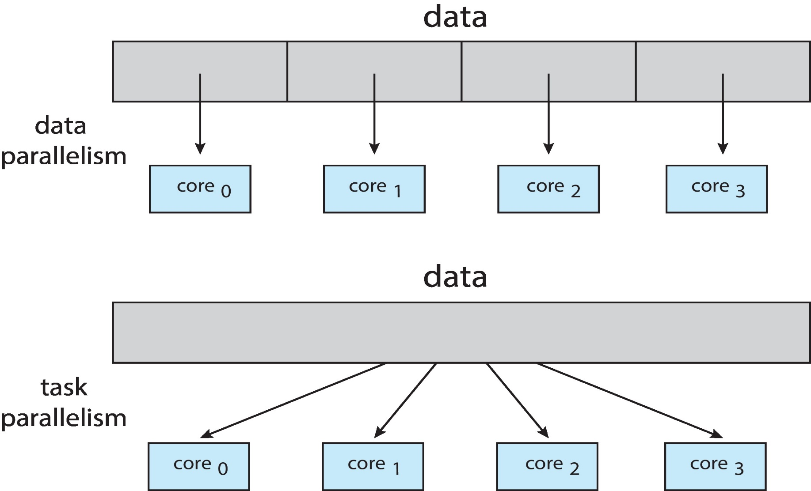
Data Parallelism and Task Parallelism

Slide 62
Q: 上述task parallelism的例子會有load imbalance的問題. Why?

Slide 63
Types of Parallelism (Cont.)
Hybrid
Most applications use data parallelism + task parallelism
Ex: summing and multiplying an array of size 1000 (if four cores)
Thread A on one core sums the element [0]…[999]
Thread B on another core performs [0]x [1]x…x[333]
Thread C on another core performs [334]x [335]x…x[666]
Thread D on another core performs [667]x [668]x…x[999]
Threads B, C, D是data parallelism
Threads A, (B, C, D)是task parallelism

Slide 64
Outline
Overview
Multicore Programming
Concurrency v.s. Parallelism
Types of Parallelism
Multi-Core Programming Challenges
Multithreading Models
Thread Library
Implicit Threading
Threading Issues
Operating-System Examples

Slide 65
Multi-Core Programming Challenges
Multicore programming is challenge
Divide activities
Divide an application into separate threads
Balance
Each thread perform equal work of equal value
Data splitting
Data accessed by each thread must be divided to run on each core
Data dependency
Discussed in Chapter 6
Testing and debugging
More difficult than single-threaded applications

Slide 66
Outline
Overview
Multicore Programming
Multithreading Models
Thread Library
Implicit Threading
Threading Issues
Operating-System Examples

Slide 67
Q: How to Support Threads?

Slide 68
Supporting Threads
思考 1:
fork() is used to create process.
所以，程式設計師需要一個function來create thread, 假設此一function 為 pthread_create()
思考 2:
fork() function is provided by OS // calling fork() calls OS’s function
So, pthread_create() is provided by ?
OS
User-level library

Slide 69
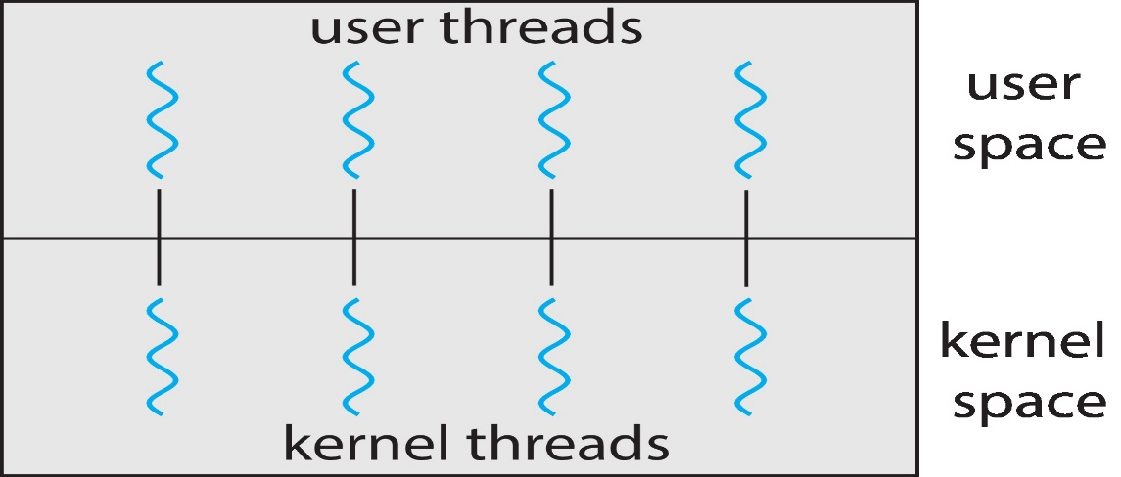
Thread Types
User threads
Support for thread is provided at the user level
Usually by user-level library
Kernel threads
Support for thread is provided at the kernel level
Usually by OS

Slide 70
Multithreading Models
Many-to-One Model
One-to-One Model
Many-to-Many Model

Slide 71
Multithreading Models
Many-to-One Model
One-to-One Model
Many-to-Many Model

Slide 72
Many-to-One
Used on systems that do not support kernel threads.
Thread management is done by thread library in user space:
Many-to-One: many user-level threads mapped to single kernel thread, i.e., kernel process
傳統沒有使用thread的processes我們視為single thread process
Good: efficient
Why? (shown later)
Bad:
Blocking problem: entire process is blocked if a thread makes a blocking system call
No support for running in parallel on MP
Since the kernel only sees a single thread (process)

Slide 73
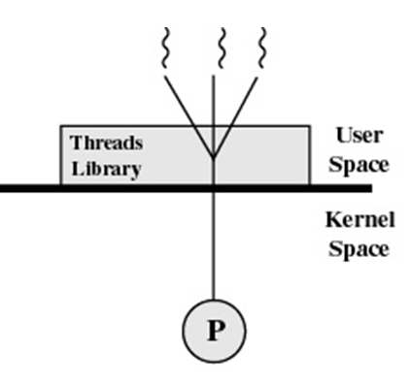
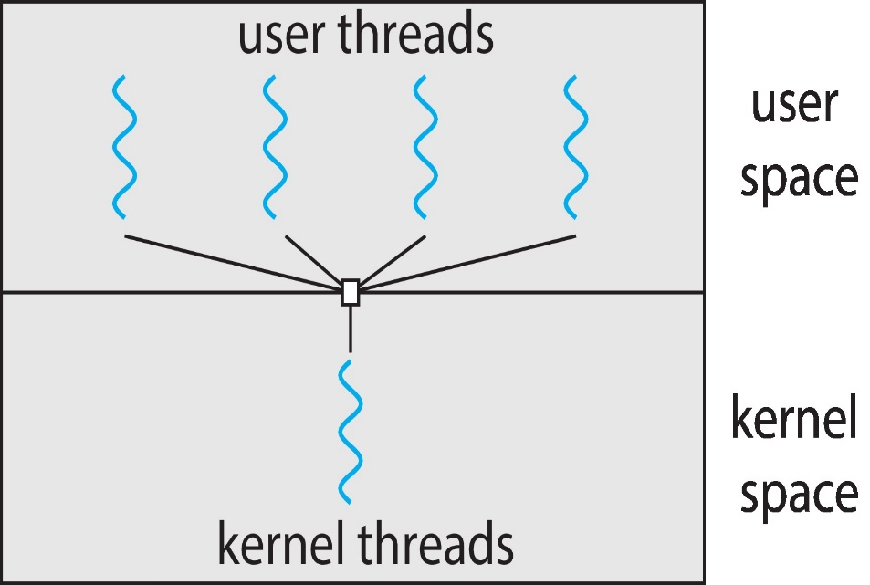
Many-to-One Model
kernel thread

Slide 74
Many-to-One Model (Assume only One Processor)
Code Section
Thread 1
main()
{
a = a +1;
pthread_create(runner());
}
runner()
{
b = b + 5;
pthread_create(readrun());
}
readrun()
{
c = c + 2;
read();
}
a process
Thread 1
Thread 1
Context switch
Thread 2
Thread 2
Thread 2
Context switch
Thread 3
Thread 3
Thread 3
Thread Library
Stack
Stack
Stack
user level
thread descriptor
thread descriptor
thread descriptor
kernel level
PCB
(process control block)
blocked
kernel thread (or kernel process)

Slide 75
Another Example: 汽車出租

Slide 76
所以, thread的管理都是由Library提供
Q: thread的管理有哪些?
Ans:分配stack空間, 建立和維護TCB, 紀錄thread的狀態, thread間的context switch, 排程thread…等等

Slide 77
Many-to-One Model
當呼叫pthread_create()時, library會知道有一個thread產生, 然後library會管理(例如產生TCB, 分配記憶體並記錄其state)並執行這個thread(例如週期性執行)
但是, OS只知道有一個process存在(因為pthread_create()只呼叫到library, OS不知道)

Slide 78
Many-to-One Model
However, very few systems continues to use this model
Cannot take advantages of multiple cores
Why? (see the following slide)

Slide 79
Many-to-One Model (Assume Three Processors)
Code Section
Thread 1
main()
{
a = a +1;
pthread_create(runner());
}
runner()
{
b = b + 5;
pthread_create(readrun());
}
readrun()
{
c = c + 2;
read();
}
a process
Thread 1
Thread 1
Context switch
Thread 2
Thread 2
Thread 2
Context switch
Thread 3
Thread 3
Thread 3
Thread Library
Stack
Stack
Stack
user level
thread descriptor
thread descriptor
thread descriptor
kernel level
PCB
blocked
PCB
CPU
CPU
CPU

Slide 80
Multithreading Models
Many-to-One Model
One-to-One Model
Many-to-Many Model

Slide 81
One-to-One
Used on systems that support kernel threads.
Each user-level thread maps to a kernel thread
Good: more concurrency
No blocking system call problem
If a thread makes a blocking system call, kernel can run another thread
Allow multiple threads to run in parallel on multiprocessors
Bad:
Creating a user thread requires creating a kernel thread
Besides, high overhead if there are many kernel threads
Thus, OS may restrict the number of user threads to be created

Slide 82
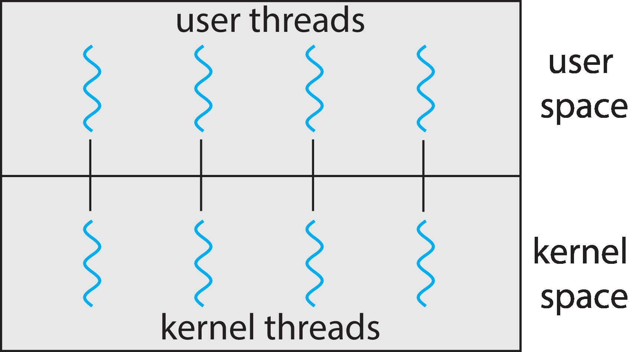
One-to-one Model

Slide 83
One-to-One Model (If Only One CPU is Available)
Thread 1
main()
{
a = a +1;
pthread_create(runner());
}
runner()
{
b = b + 5;
pthread_create(readrun());
}
readrun()
{
c = c + 2;
read();
}
Thread 1
Code Section
Thread 1
context switch
Thread 2
Thread 2
Thread 2
context switch
Thread 3
Thread 3
a process
Thread 3
context switch
clone()
clone()
Thread Library
thread descriptor
thread descriptor
thread descriptor
kernel level
Stack
Stack
Stack
PCB
(process control block)
Kernel
thread
descriptor
Kernel
Thread
descriptor
Kernel
Thread
descriptor
run
run
run
ready
ready
waiting

Slide 84
One-to-One Model (If Three CPU Cores are Available)
main() {
pthread_create(runner());
x = x +1;
y = y + 1;
}
runner() {
pthread_create(readrun());
i = i + 6;
j = j * 8;
}
readrun()
{
c = c + 2;
d = 10 ;
}
a process
Thread 1
Thread 1
If three CPU cores are available, these three threads can run in parallel
Thread 2
Thread 2
Thread 3
Thread 3
Thread Library
thread descriptor
thread descriptor
thread descriptor
user level
kernel level
Stack
Stack
Stack
PCB
(process control block)
Kernel
thread
descriptor
Kernel
Thread
descriptor
Kernel
Thread
descriptor

Slide 85
當程式呼叫pthread_create(), 最終會呼叫到clone() system call, 所以OS會知道有一個thread的存在
同理, OS會分配資源給這個thread,產生TCB, 並分配CPU執行

Slide 86
Q: 在上圖的例子中, 如果其中一個thread做blocking的system call(例如: read()), 會發生什麼事呢?

Slide 87
Q: 在之前many-to-one model, 我們提到其優點為efficiency. Why?
Hint: 也就是many-to-one model比one-to-one model efficient. Why?

Slide 88
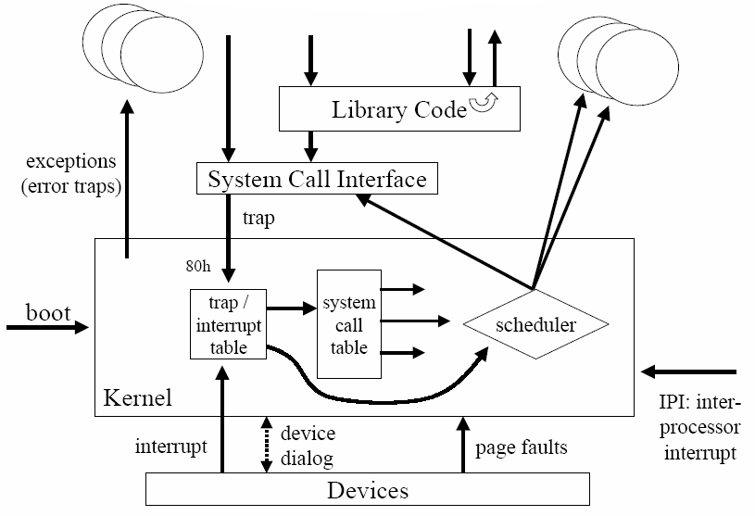
複習：System Call Overhead > Library Call Overhead

Slide 89
補充：System Call Overhead
System call overhead (skip!)
Mode switch cost
State save
System call table lookup
...
FlexSC: Flexible System Call Scheduling with Exception-Less System Calls
Summary:
System calls incur quite a large overhead compared to function calls.

Slide 90
所以, thread的管理都是由OS提供

Slide 91
One-to-One
Current OS use this model
Windows, Linux, Solaris 9 and later

Slide 92
Multithreading Models
Many-to-One Model
One-to-One Model
Many-to-Many Model

Slide 93
Many-to-Many Model
Problems of previous two models
Many-to-one: true concurrency is not gained
One-to-one: cannot create too many user threads
Many-to-many
Allows M user level threads to be mapped to N kernel threads, where N <= M
Many-to-many
True concurrency is guaranteed
Kernel thread can run in parallel on a multiprocessor
No blocking system call problem
Unlimited number of user threads
User can create as many user threads as possible

Slide 94
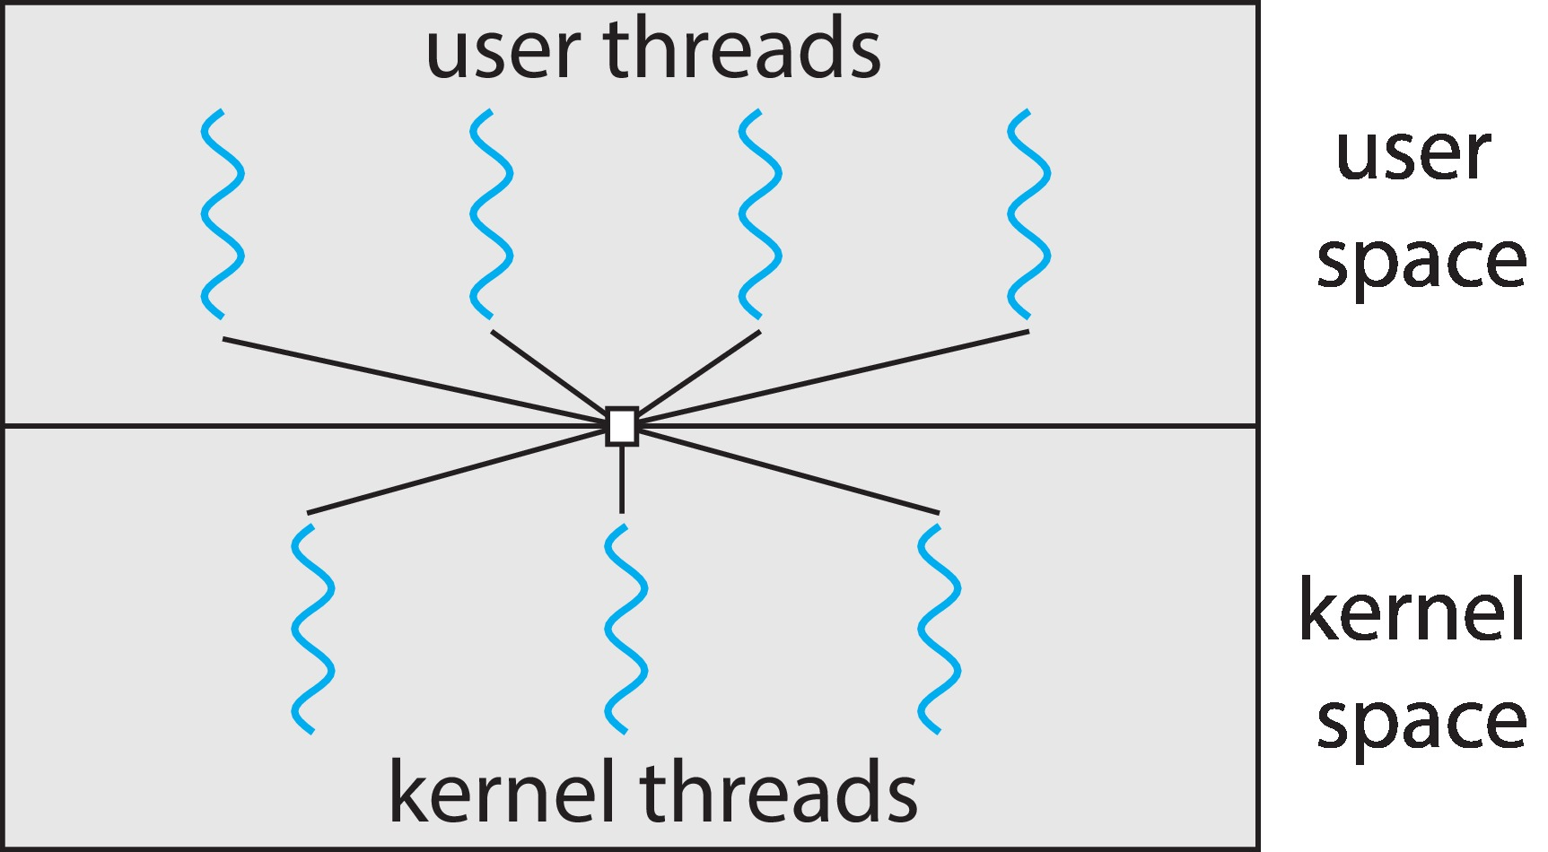
Many-to-Many Model
The number of user threads and kernel threads may vary with time. But the maximum number of kernel thread is limited to 3, no matter how many user threads.

Slide 95
你可以自己畫類似前面Pages的動畫嗎？

Slide 96
Many-to-Many Model (Cont.)
Two-level Model: one variation on many-to-many
Two-level model = many-to-many + one-to-one models
Although many-to-many is the most flexible
Difficult to implement (addressed in Section 4.6.5)
Limit the number of kernel threads is becoming less important
Since there is an increasing number of processing core
Thus, most OS use one-to-one model

Slide 97
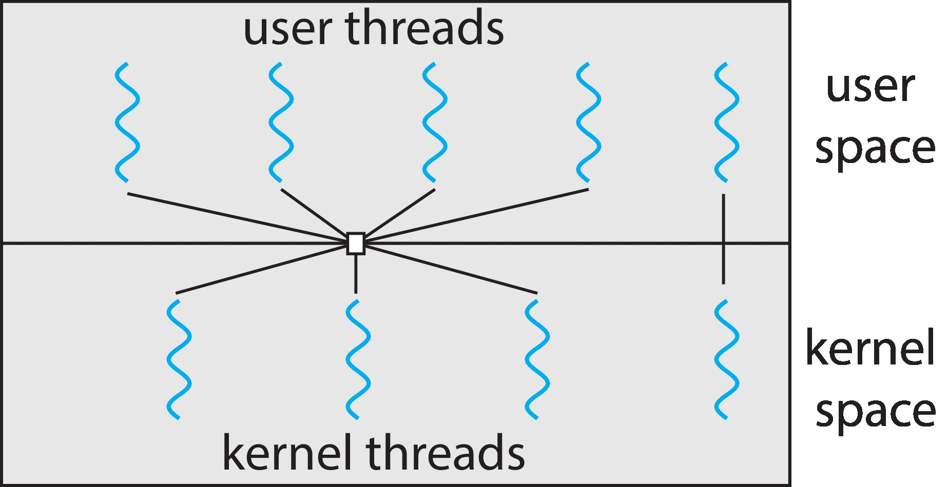
Two-level Model

Slide 98
結論: M-to-1(user thread)和1-to-1(kernel thread)的優缺點?

Slide 99
Summary: User Thread vs. Kernel Thread
User thread (many-to-one model)
Thread management done by user-level threads library
The kernel is not aware of the existence of threads
Fast to create and manage
Invoke a function in the library is a local function call in user space
Block all threads for a blocking system call
Cannot take advantage of multi-processors
Examples
POSIX Pthreads
Win32 threads
Java threads

Slide 100
Summary: User Thread vs. Kernel Thread (Cont.)
Kernel thread (one-to-one model)
Supported by the kernel
Slower to create and manage
Invoke a function in the library is a system call to the kernel
No blocking system call problem
Can take advantage of a multi-processor environment
Examples
Windows
Solaris
Linux

Slide 101
Outline
Overview
Multicore Programming
Multithreading Models
Thread Library
Implicit Threading
Threading Issues
Operating-System Examples

Slide 102
Thread Library
Provide an APIs for creating and managing threads

Slide 103
Strategies for Creating Threads
Strategies for Creating Threads
Asynchronous threading v.s. synchronous threading

Slide 104
Asynchronous threading
Asynchronous threading
After creating child thread, parent thread resumes its execution
Parent thread and children threads run concurrently
Multithreaded Server using asynchronous threading

Slide 105
Asynchronous Threading Example: Multi-Threaded File Server
thread
thread
thread
thread
1. Receive requests
2. create a thread to service the request
3. And so on…
Dispatcher thread
Multi-thread I/O model. Each thread handles 1 client at a time.
https://www.rubyraptor.org/how-we-made-raptor-up-to-4x-faster-than-unicorn-and-up-to-2x-faster-than-puma-torquebox/

Slide 106
Synchronous Threading
Synchronous Threading
After creating child thread, parent thread waits for all children threads to terminate
For example, in an array summation example (see the following slide)
Parent thread must wait until all children threads calculate the partial sums
Then, parent thread calculate the final sum

Slide 107
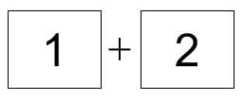
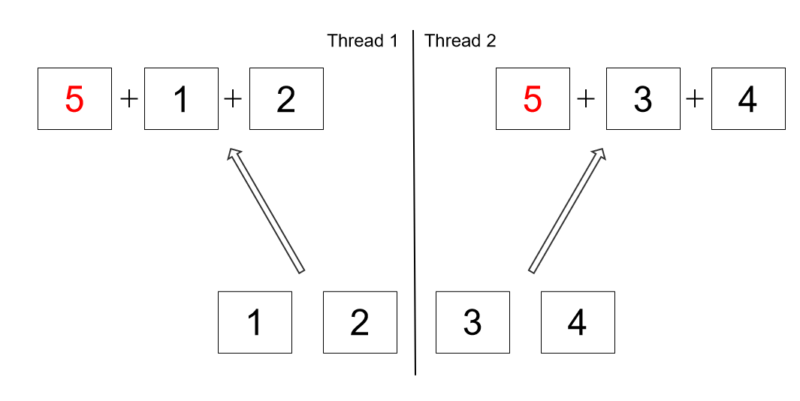
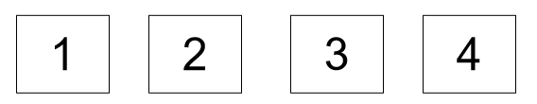
Synchronous Threading Example: Array Summation
thread 0
3
7
thread 1
thread 2
Thread 0 creates threads 1 and 2 and waits for their execution

Slide 108
Thread Library (Cont.)
Three main thread libraries
POSIX Pthreads (Pthreads)
Can be provided as a user- or kernel-level library
Win32 threads (skip!)
Kernel-level library
Java threads (skip!)
Use thread library available on the host system, typically
Use Win32 threads in Windows
Use POSIX Pthreads in UNIX or Linux

Slide 109
Outline
Overview
Multicore Programming
Multithreading Models
Thread Library
Pthreads
Windows Threads
Java Threads
Implicit Threading
Threading Issues
Operating-System Examples

Slide 110
Pthreads
A POSIX standard (IEEE 1003.1c) API
Common in UNIX operating systems
Solaris, Linux, Mac OS X

Slide 111
The Pthreads API (Incomplete)
Implementation, e.g., pthread_create(), is up to development of the library
Table 1. POSIX thread management functions (incomplete).

Slide 112
Example
A Pthreads example
A thread begins with main()
main() creates a second thread by calling pthread_create()
Wait for a thread to terminate by calling pthread_join()
This example uses asynchronous threading

Slide 113
Example 1
#include <pthread.h>
#include <stdio.h>
int sum;
Void *runner(void *param)
int main (int argc, char *argv[])
{
pthread_t tid; /* the thread identifier */
pthread_attr_t attr; /* set of thread attributes */
// set default thread attributes, e.g. stack size, scheduling info.
pthread_attr_init(&attr);
// create the thread, using the default attributes
pthread_create(&tid, &attr, runner, argv[1]);
// wait for the thread to exit
pthread_join(tid, NULL);
printf(“sum = %d\n”, sum);
}
void *runner (void *param)
{
int i, upper = atoi(param); //converts the string param to an integer
sum=0;
for (i = 1; i <= upper; i++)
sum += i;
pthread_exit(0);
}

Slide 114
Example 2
Above example creates only one thread
If several threads are created
Calling pthread_join()10 (=NUM_THREADS) times

Slide 115
作業系統實驗會有一個Pthread Programming的實驗

Slide 116
Outline
Overview
Multicore Programming
Multithreading Models
Thread Library
Implicit Threading
Threading Issues
Operating-System Examples

Slide 117
Implicit Threading
Due to multicore computers, applications may contains hundreds, or even thousands, of threads
But, design such an multi-threading application is not easy
Address the challenges in page 34
Synchronous and deadlock issue (chapter 6 and 7)
Your solution?
Hint: 減少程式設計師的負擔

Slide 118
Implicit Threading
Solutions: implicit threading

Slide 119
複習： Explicit Threading
#include <pthread.h>
#include <stdio.h>
int sum;
Void *runner(void *param)
int main (int argc, char *argv[])
{
pthread_t tid; /* the thread identifier */
pthread_attr_t attr; /* set of thread attributes */
// set default thread attributes, e.g. stack size, scheduling info.
pthread_attr_init(&attr);
// create the thread, using the default attributes
pthread_create(&tid, &attr, runner, argv[1]);
// wait for the thread to exit
pthread_join(tid, NULL)
printf(“sum = %d\n”, sum);
}
void *runner (void *param)
{
printf("Hello World! It's me, thread #%d!\n", tid);
pthread_exit(NULL);
}

Slide 120
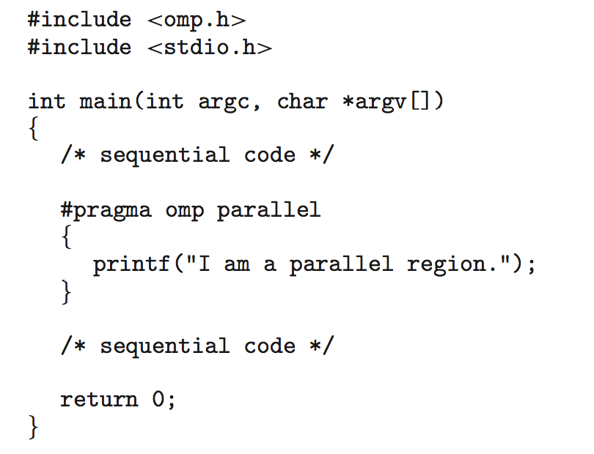
Implicit Threading Example

Slide 121
問題:在前一頁implicit threading的例子中,如何產生threads和管理threads?
Hint: 程式設計師不做, 代表有其他人必須處理
其他人是誰?

Slide 122
Implicit Threading
Implicit threading
Creation and management of threads are done by compilers and libraries (shown later), rather than programmers

Slide 123
Implicit Threading
OpenMP in C and C++
Grand Central Dispatch in Mac OS and iOS
Thread Building Blocks by Intel
Fork Join in Java
Summary

Slide 124
OpenMP
Consists of compiler directives and APIs for C, C++, or FORTRAN
What is compiler directives? (shown later)
Define parallel regions
Blocks of code that can run in parallel
Programmers only insert compiler directives to identify parallel regions
Then OpenMP library executes the region in parallel

Slide 125
Q: What is a directive?
Hint: compiler directive and assembler directive

Slide 126
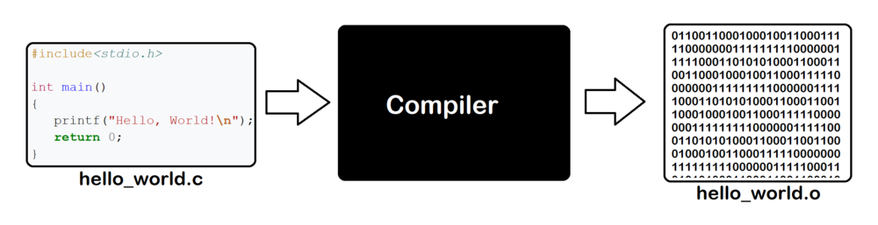
複習：Compiler and Compiler Directive
Compiler directive
Source file
Object file

Slide 127
複習：Assembler Directives
Directives: commands that are recognized and acted upon by the assembler
Command understood only by the assembler
Not part of Intel instruction set
Do no execute at run time (since not instruction)

Slide 128
複習： Outline
Data Transfer Instructions
Addition and Subtraction
Data-Related Operators and Directives
ALIGN Directive
LABEL Directive
Indirect Addressing
JMP and LOOP Instructions

Slide 129
ALIGN Directive
To align a variable on a byte, word, doubleword boundary
Why alignment?
CPU can process data stored at even-numbered addresses more quickly than those at odd-numbered addresses.
bVal BYTE ? ; 00404000
ALIGN 2
wVal WORD ? ; 00404002
bVal2 BYTE ? ; 00404004
ALIGN 4
dVal DWORD ? ; 00404008
dVal2 DWORD ? ; 0040400C

Slide 130
複習結束

Slide 131
Example 1
Ex1: #pragma omp parallel
Create as many threads as there are CPU cores
…
a = a + 1;
Compiler directive
parallel
region
x = x + 1;
…

Slide 132
Creation and Management of Threads are Done by Compilers and Libraries
Execution
file
a = a + 1;
#pragma omp parallel
{
printf(“Parallel region.”);
}
x = x + 2;
a = a + 1;
my_library_for_thread ();
Compiler-generated code
compiler
x = x + 2;
……
must recognize the directive (parallel region)
my_library_for_thread()
{
mythread_create();
mythread_create();
…
mythread_join();
mythread_join();
}
library
clone()……
OS

Slide 133
Example 2
Ex2: #pragma omp parallel for
for(i=0;i<N;i++) {
c[i] = a[i] + b[i];
}
Run the for loop in parallel
OpenMP divides the work in the for loop among the threads that it creates (shown in the following slide)

Slide 134
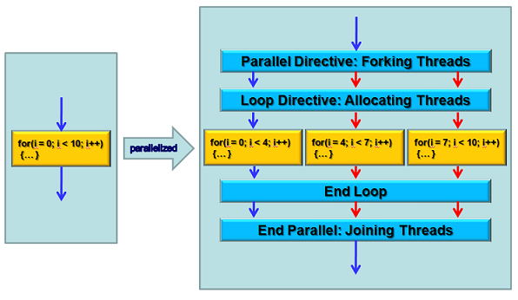
Transfer to Pthreads by OpenMP Library
These three for loops (determined by library)
are then executed by three threads
http://aaz-blogger.blogspot.com/2011/03/openmp-parallel-construct.html

Slide 135
Implicit Threading
OpenMP
Grand Central Dispatch in Mac OS and iOS (Skip!)
Thread Building Blocks by Intel (Skip!)
Fork Join in Java (Skip!)
Summary

Slide 136
Implicit Threading
OpenMP
Grand Central Dispatch in Mac OS and iOS (Skip!)
Thread Building Blocks by Intel (Skip!)
Fork Join in Java (Skip!)
Summary

Slide 137
Summary
Implicit Threading
Application developers only needs to identify tasks—not threads—that can run in parallel.
Then run-time library/compiler maps tasks to threads, and perform the thread creation and management
Advantages
Developers only needs to identify what operations can run in parallel
The compiler/library manages the details

Slide 138
Outline
Overview
Multicore Programming
Multithreading Models
Thread Library
Implicit Threading
Threading Issues
Operating-System Examples

Slide 139
Thread雖然有許多優點, 但也有一些議題需要解決~

Slide 140
Outline
Overview
Multicore Programming
Multithreading Models
Thread Library
Implicit Threading
Threading Issues
Thread Pools
Semantics of fork() and exec() system calls
Signal handling
Thread cancellation
Thread-Local Storage
Operating-System Examples

Slide 141
Thread Pools
雖然threads比process節省資源…但還是需要資源
Example: consider a web server that service each request with a thread
Creating and destroy threads dynamically – time consuming
Unlimited number of threads – exhaust system resources

Slide 142
Q: Your solution?

Slide 143
Thread Pools
Sol.: Thread Pools
Create a number of threads in a pool in advance
Receiving a request → awaken a thread from the pool → pass it the request to service
Once the thread completes its service → return to the pool
If no available thread → server waits until one becomes free

Slide 144
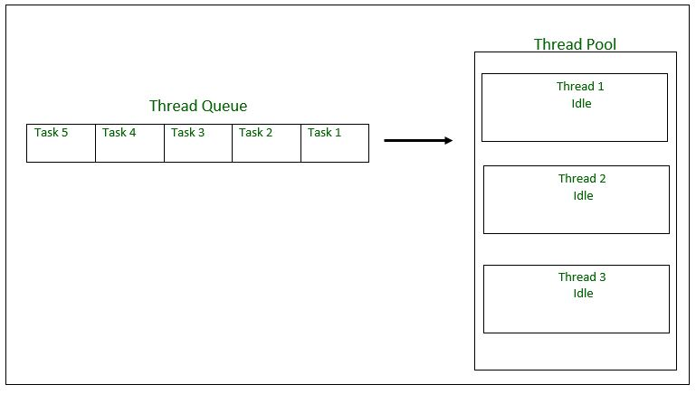
Thread Pools: Before
Task Queue
https://iter01.com/29330.html

Slide 145
Thread Pools: After
Task Queue
Running task 1
Task 5
Task 4
Running task 2
Running task 3
https://iter01.com/29330.html

Slide 146
Thread Pools (Cont.)
Advantages:
Faster to service a request
By an existing thread rather than creating a new thread
Allow the number of threads in the application(s) to be bound to the size of the pool

Slide 147
Outline
Overview
Multicore Programming
Multithreading Models
Thread Library
Implicit Threading
Threading Issues
Thread Pools
Semantics of fork() and exec() system calls
Signal handling
Thread cancellation
Thread-Local Storage
Operating-System Examples

Slide 148
Q: What is syntax? What is semantics?

Slide 149
Q: 如果一個thread呼叫fork(),會發生什麼事呢?

Slide 150
Semantics of fork()
fork() in a multi-thread application?
If one thread calls fork()
Duplicate all threads or
Duplicate only the thread that invoked fork()
Some UNIX system supports two versions of fork()

Slide 151
Semantics of fork()
Q: 以下頁為例, 如果T2呼叫fork()
Duplicate all threads會發生什麼事?
產生一個新的process, 包含T2一個threads
Duplicate only the thread that invoked fork()會發生什麼事?
產生一個新的process, 包含所有三個threads

Slide 152
One Process with Three Threads
…
…
…
…
…
…..
T1 TCB
pc = x, eax=y, …..,
OS
T2 TCB
pc = i, eax=j, …..,
OS
T3 TCB
pc = i, eax=j, …..,

Slide 153
Q: 如果一個thread呼叫exec(),會發生什麼事呢?

Slide 154
Semantics of exec()
How about exec()?
Upon a thread invokes the exec() system call
Replace the entire process – including all threads
Why?
Threads share the .code section

Slide 155
Outline
Overview
Multicore Programming
Multithreading Models
Thread Library
Implicit Threading
Threading Issues
Thread Pools
Semantics of fork() and exec() system calls
Signal handling
Thread cancellation
Thread-Local Storage
Operating-System Examples

Slide 156
作業系統實驗會有一個Signal Handling的實驗

Slide 157
複習：Event-Driven OS: Trap (Error)
…
a = b/0;
…
CPU
…..
trap
OS
OS該怎麼辦呢？

Slide 158
Signal Handling
Signals are used in UNIX systems to notify a process that an event has occurred
Events
Illegal memory access
Divided by zero…
Ctrl-C to terminate a process
Timer expires
…

Slide 159
Signal Handling (Cont.)
All signals follow the same pattern
1. Signal is generated by a particular event
2. Signal is delivered to a process
3. Signal is handled by the process’s signal hander
Each signal is handled by one of two handlers
A user-defined signal handler in the user program
A default signal handler in the kernel

Slide 160
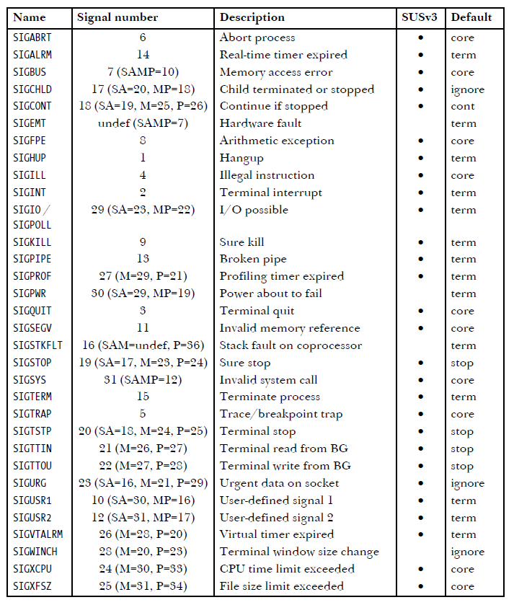
Signal Types and Default Actions

Slide 161
Signal Handling (Cont.)
In single-threaded programs, signals are delivered to a process
Q: in a multi-threaded programs, signal要送給哪一個thread?

Slide 162
Signal Handling (Cont.)
Sol.: In a multi-threaded programs (skip!)
Deliver the signal to the thread to which the signal applies
Example: Illegal memory access, divided by zero
Deliver the signal to every thread in the process
Example: a Ctrl-C asynchronous signal
Deliver the signal to certain threads in the process
pthread_kill( pthread_t tid, int signal)
Assign a specific thread to receive all signals for the process

Slide 163
Outline
Overview
Multicore Programming
Multithreading Models
Thread Library
Implicit Threading
Threading Issues
Thread Pools
Semantics of fork() and exec() system calls
Signal handling
Thread cancellation
Thread-Local Storage
Operating-System Examples

Slide 164
Thread Cancellation
Thread Cancellation (取消)
Terminate a thread before it has completed
Example:
Searching a database using multiple threads
If one thread finds the result, cancel other threads
猜密碼
If one thread 猜到密碼，cancel other threads

Slide 165
Q: 突然取消一個thread的執行可能會發生什麼問題呢?

Slide 166
Thread Cancellation (Cont.)
Target thread: the thread to be canceled
However, terminates the target thread immediately may have problems in resource reclaim (資源回收利用)
例如: the target thread is in the midst of updating a shared data (e.g., inserting an element into a doubly linking list)
例如: the target thread is holding resources (e.g., mutex)(shown later)

Slide 167
Thread Cancellation (Cont.)
Two approaches for thread cancellation:
Asynchronous cancellation
Terminates the target thread immediately
May have problems addressed in previous slide
Deferred cancellation (default in POSIX)
Target thread periodically check if it should terminate
Allow the target thread to terminate itself in a safe point, called cancellation point

Slide 168
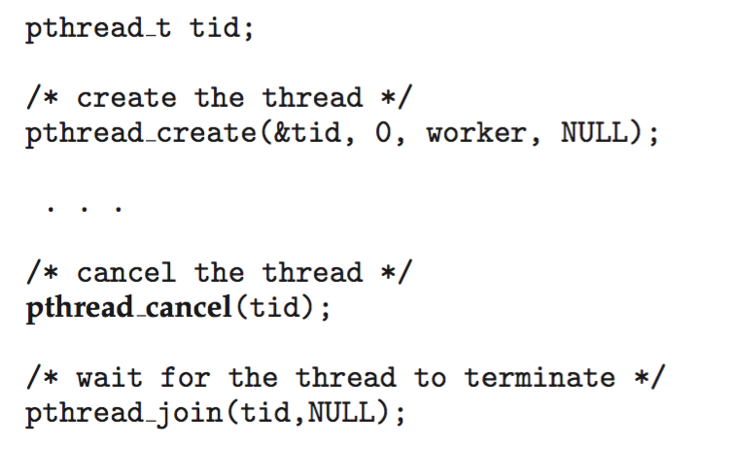
Example: Pthread
Cancel a target thread: call pthread_cancel()
Example:

Slide 169
Example: Pthread
Invoking pthread_cancel() indicates only a request to cancel the target thread
But actual cancellation depends on the setting of the target thread
Default type is deferred
Upon receiving a cancellation request, cancellation only occurs when thread reaches cancellation points
e.g, calling pthread_testcancel()
See the following slide

Slide 170
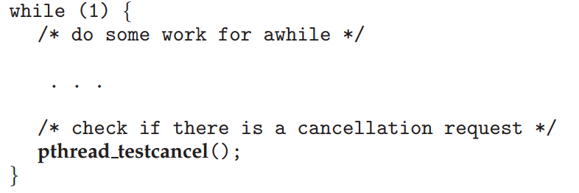
Example：Pthread_testcancel()

Slide 171
作業系統實驗會有一個Thread Cancellation的實驗

Slide 172
Outline
Overview
Multicore Programming
Multithreading Models
Thread Library
Implicit Threading
Threading Issues
Thread Pools
Semantics of fork() and exec() system calls
Signal handling
Thread cancellation
Thread-Local Storage
Operating-System Examples

Slide 173
Thread-Local Storage
Although threads belonging to the same process share the data
Sometimes, each thread might need its own copy of certain data
Solution: Thread-local Storage (TLS)
Allows each thread to have its own copy of data
Different from local variables
Local variables visible only during the closing function
TLS visible across function invocations

Slide 174
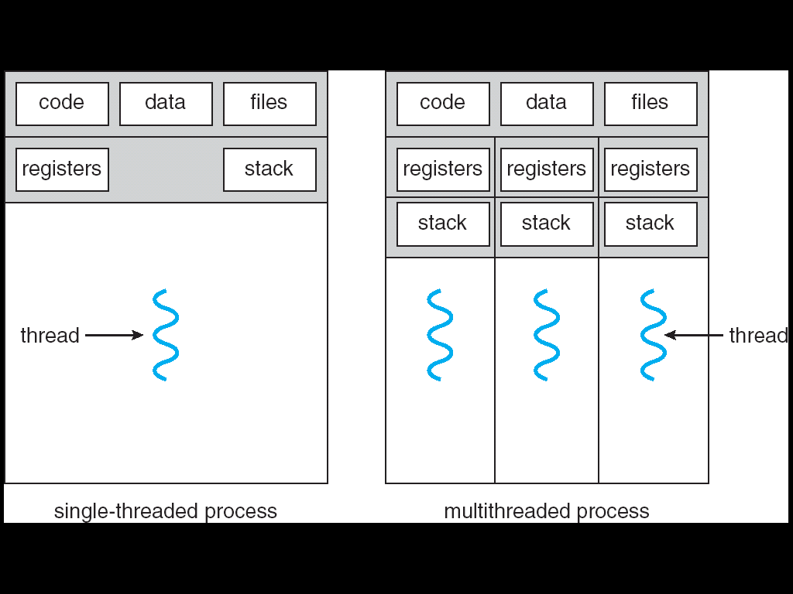
Single and Multithreaded Processes
thread-local
storage

Slide 175
作業系統實驗會有一個Thread-Local Storage的實驗

Slide 176
Outline
Overview
Multicore Programming
Multithreading Models
Thread Library
Implicit Threading
Threading Issues
Operating-System Examples

Slide 177
Linux Threads
Linux refers to them as tasks rather than threads
Thread creation is done through clone() system call
clone() allows how much sharing between parent and child tasks
CLONE_FS: share the same file-system information
CLONE_VM: share the same memory space
CLONE_SIGHAND: share the same signal handler
CLONE_FILES: share the same set of open files
If all above flags are set
clone() is similar to create a thread
If none of flags are given
clone() is similar to the fork()

Slide 178
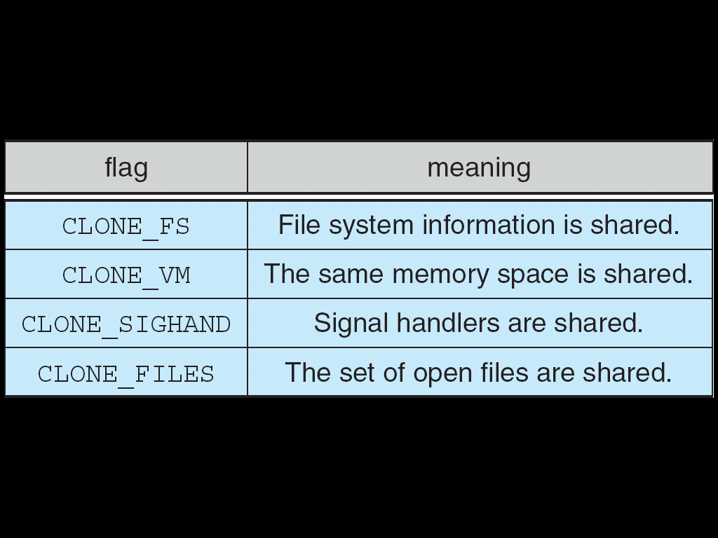
A Sets of Flags to clone()

Slide 179
所以, 程式呼叫pthread_create(), library會再呼叫clone() system call
OS就會知道有一個thread的存在, 為此thread建立資源(TCB, 記憶體…)並分配CPU執行這個thread

